Slide 1
Open Domain Question Answering Using Early Fusion of Knowledge Bases and Text
Haitian Sun, Bhuwan Dhingra, Manzil Zaheer, Kathryn Mazaitis, Ruslan Salakhutdinov, William W. Cohen
Carnegie Mellon University
‘EMNLP 18’
Happy Buzaaba
UNIVERSITY OF TSUKUBA
Notes:
Today I am going to present this paper called Open domain question answering Using Early fusion of knowledge base and Text It appeared in the 2018 proceedings of empirical methods in natural language processing.

Slide 2
Presentation Outline
Introduction
Representation of Text and Knowledge Base
Embedding Propagation on graphs
Results and Discussion
Notes:
This is the outline of my presentation and I will start by introducing the topic of Open domain question answering

Slide 3
Open Domain Question Answering
The task of answering factual questions posed in natural language
Example:
- Who voiced Meg in Family Guy?
Lacey Chabert
- Which club did Christiano Ronaldo play for in 2011?
Real Madrid
Open-domain: Need to search for the answer in Web-scale data
Introduction
February 20, 2019
Notes:
For example if we have a question like this;
who voiced meg in family guy?
the real answer is
So here I would like to emphasize open-domain where we need to search for the answer in a web scale data
It is also important to note here that this different from the reading comprehension where the assumption is that the answer always exist in the provided paragraph.

Slide 4
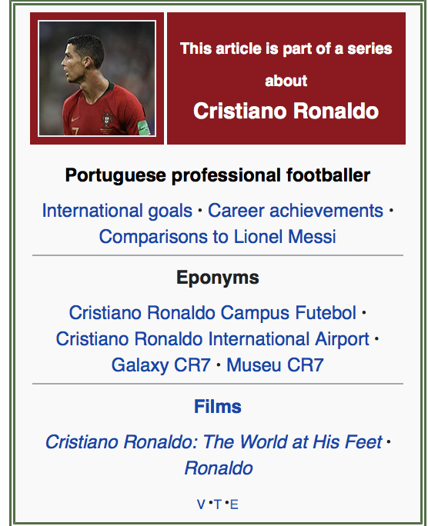
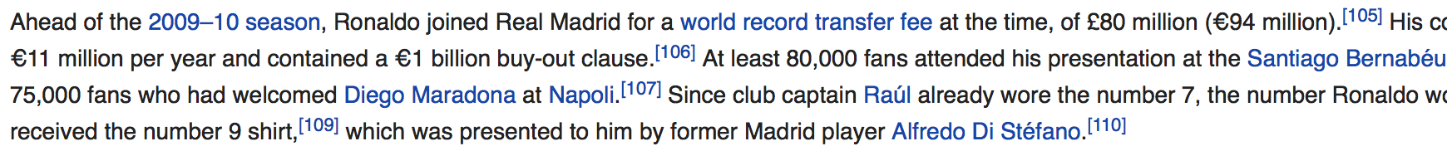
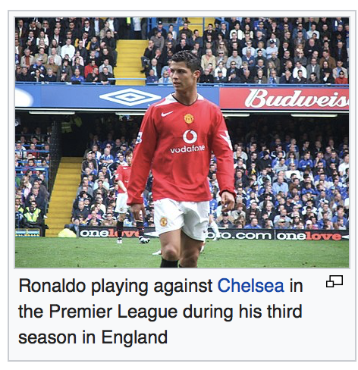
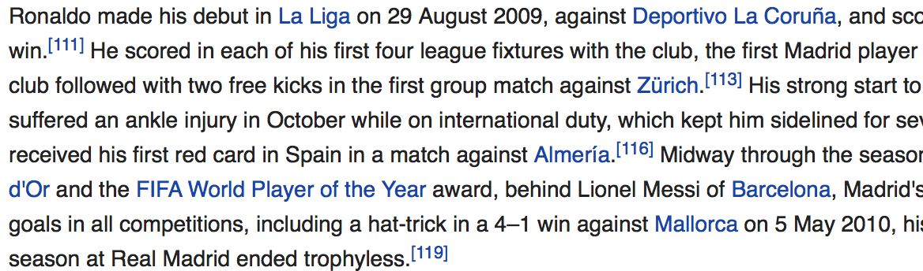
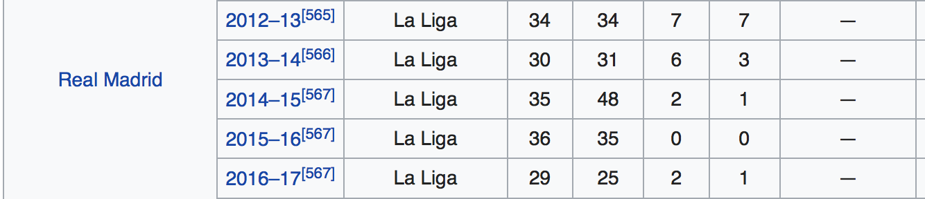
Structured and Unstructured Knowledge
Text
Figure
Table
Introduction
February 20, 2019
Notes:
So lets talk about the knowledge sources we can use to answer the question.
This is a wikipedia page where we have text, figure and table.
So when a human is trying to find an answer from Wikipedia, he or she will try to use all this information to find the answer.
So what can a machine do?

Slide 5
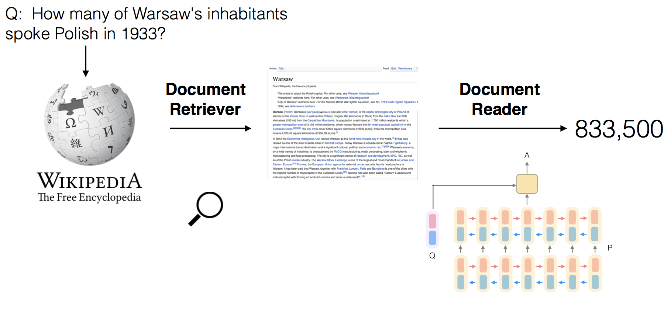
Question answering with unstructured Knowledge (Text)
Reading Comprehension:
DrQA: Reading wikipedia to answer Open Domain Questions (chen et al, ACL 2017)
NB: High coverage of answers, but generally difficult to extract the answer in open-domain setting.
Related work
February 20, 2019
Notes:
There are machine learning algorithms that work on question answering tasks using text for example the reading comprehension model the DrQA.
And what does it do?
Given the question, they go to Wikipedia and retrieve some text relevant to the question, and then write a text reader to find the exact answer to the question.
So the advantage of using Text for QA is that it always has a large coverage of answer, but it is generally difficult to extract the exact answer in the open domain setting.

Slide 6
Question Answering with Structured Knowledge (KB)
Knowledge Base
(Subject, relation, Object)
Example, (Meg_Griffin, voiced_by, Milla_Kunis)
Semantic Parsing:
Example, Neural Symbolic Machine (Liang et al, ACL 2017)
Who voiced Meg in Family Guy?
Meg Griffin
argmin
from
character
Family Guy
cast
y
actor
x
NB: High precision, but knowledge base is always incomplete.
Related work
February 20, 2019
Notes:
Another Interesting Knowledge source that we always use for question answering is knowledge base.
Knowledge bases usually have a lot of facts which are structured in the form of (subjects, relation, objects) for example
(Meg_Griffin, voiced_by, Mila_kunis)
One popular way of doing QA over KB is semantic parsing where by a NLQ is converted into a sequence or formal representation that is given to the knowledge base and then returns an answer.
This type of algorithm on the knowledge base usually yield high precision, but the problem is that the KB is always incomplete.
So the answer doesn’t exist in the KB and there is no way you can find an answer.

Slide 7
Question Possibility of jointly using Structured and Unstructured Knowledge in QA
Notes:
So the question that this paper is trying to ask is how possible is it to jointly use structured and unstructured knowledge sources in QA and the paper suggests two options but focus on one.

Slide 8
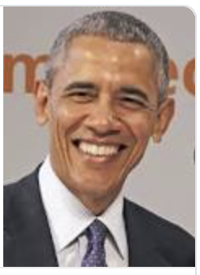
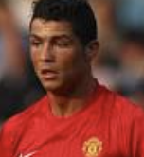
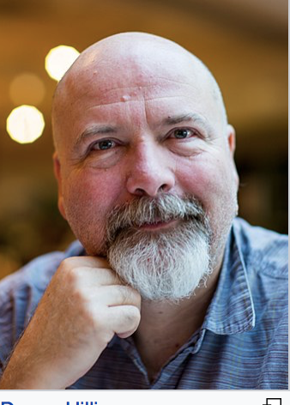


Question Answering with Structured and Unstructured Knowledge
Option 1 Late Fusion
- Train QA system on each Knowledge Source separately, and then ensemble the predictions
Option 2: Early Fusion
- Combine all knowledge sources into a single data structure
Results
Results
Joint_model
KB_Model
Text_model
Pic_model
Combined data structure
Problem
February 20, 2019
Notes:
The first option is called late fusion, and this is basically to train a QA system on each of the knowledge source separate and then ensemble the predictions.
The second option is called early fusion where by they combine the knowledge source into one single data structure and then train one model to inference from this data structure and find the prediction.

Slide 9
Proposed Model
GRAFT-Nets
Can we use multiple knowledge sources for question answering
- Text and incomplete KB
Is early fusion better than late fusion
Model
February 20, 2019
Notes:
And so to do this they Propose a model called Graft-net to find out if they can possibly use multiple knowledge sources for QA
And they use two knowledge sources Text and the incomplete KB, and here I emphasize Incomplete because in the real scenario of QA the KB is always incomplete.
And also they try to ask that we focus on early fusion but is it better than late fusion?

Slide 10
Presentation Outline
Introduction
Representation of Text and Knowledge Base
Embedding Propagation on graphs
Results and Discussion
Results
Joint_model
Combined data structure
Notes:
So In the next part I will talk about how they design the combined data structure.
That contains both text and KB

Slide 11
Representation of Text and Knowledge Base
KB Facts:
(Meg_Graffin, Voiced_by, Lacey_Chabert)
(Family_Guy, has_character, Meg_Graffin)
Meg_Graffin
has_character
voiced_by
Family_Guy
Lacey_Chabert
KB_Entity
KB Relation
Combined data structure
February 20, 2019
Notes:
So give the KB facts, it is very natural to represent it on the graph this way, so the entity is represented as a node and the relations represented as edge.
So in this paper they make an abstraction and put the relations on the side which becomes a bipartite graph.

Slide 12
Representation of Text and Knowledge Base
KB Facts K :
- (Meg_Graffin, Voiced_by, Lacey_Chabert)
- (Family_Guy, has_character, Meg_Graffin)
K = (V, ε, R)
V: set of entities,
ε: edges are triplets (s, r, o) where
r ϵ R holds between s ϵ V and o ϵ V
Text D :
“Meg was originally voiced by Lacey Chabert
during the first season ….”
D : {d₁, d₂, ……, d_{|D|}}
d : (w₁, w₂, …., w_{|di|})
Meg_Graffin
L_{d} : {v, d_{p}}
voiced_by
Family_Guy
Meg was originally voiced by Lacey Chabert during the first season….
has_character
Lacey_Chabert
KB_Entity
Text Document
KB Relation
Entity Mention
bipartite graph/ Combined data structure
February 20, 2019
Notes:
So for the first fact for example we start from Meg_griffin which is the subject entity which goes to voiced by the relation node and then we come back to the object which is another entity node.
And for the text, an entity linking is run on a collection of documents which outputs a set of links that connects KB entities to the word at position p in the document.

Slide 13
Representation of Text and Knowledge Base
Given NLQ: q = (w₁, w₂, …., w_{|q|}) extract an answer to the question {a_{|q|}} from the g = (K, D, L)
Steps for answer extraction:
Extracting subgraph g_{q} ϵ g which contains an answer to the question to ensure high recall for answers
Use Graft-net to learn Node representation in the g_{q} conditioned to the question which are then used to classify the node as answer or not.
Answer extraction
February 20, 2019
Notes:
So here the assumption is that the answer to the question is an entity from either the KB or the Corpus.
Since there might be multiple answers when they are actually looking for a single entity,
To extract an answer to the question, they follow two steps:
In the next slide I will talk about how to extract the sub graph

Slide 14
Extracting Sub-graph from graph
KB Retrieval:
Entity linking on question to produce seed entities S_{q}
Run PPR (Haveliwala, 2002) around S_{q} to identify top 50 entities which might be an answer to the question
Add the Top entities by PPR score and edges between them to the g_{q}
Text Retrieval:
Retrieve top 5 most relevant Wikipedia articles using weighted bag of words model from (Chen et al 2017)
Populate Lucene index with sentences from the article and retrieve the top ranking documents based on words in the question.
Add the retrieved documents with entities linked to them to the g_{q}
Sub-graph extraction
February 20, 2019
Notes:
Two extract a subgraph they apply two parallel pipelines:
One is over the KB which returns a set of entities and the other over the corpus which returns a set of documents. The retrieved entities and documents are then combined with entity links to produce a fully connected graph.
So given the question: first identify entity me

Slide 15
Sub-graph
Final Sub-graph becomes: g_{q} = (V_{q}, ε_{q}, R⁺). Where;
V_{q} : All retrieved entities and Documents
V_{q} = {v₁, v₂, …….., v_{E}} U {d₁, d₂, ………, d_{D}}
ε_{q} : All relations from the KB and entity links between documents and entities
ε_{q} = {(s, r, o) ϵ ε: s,o ϵ V_{q,} r ϵ R} U {(v, d_{p,} rL): (v, d_{p}) ϵ L_{d}, d ϵ V_{q}}
R⁺ : Set of all edge types in the subgraph
R⁺ = R U {rL}
Subgraph
February 20, 2019
Notes:
Two extract a subgraph they apply two parallel pipelines:
One is over the KB which returns a set of entities and the other over the corpus which returns a set of documents. The retrieved entities and documents are then combined with entity links to produce a fully connected graph.

Slide 16
Presentation Outline
Introduction
Representation of Text and Knowledge Base
Embedding Propagation on graphs
Results and Discussion
Results
Joint_model
Combined data structure
Notes:
So given this combined data structure, how is the model designed?
They design their model in the embedding propagation type of methods and what does this mean?

Slide 17
Embedding Propagation
Q. Who voiced Meg in Family Guy?
Question subgraph
T=0
Meg_Griffin
T=1
Voiced_by
T=0
Meg was originally voiced by Lacey Chabert during the first season….
Family_Guy
T=1
Character-in
T=2
Lacey Chabert
…..
…..
T=3
KB_Entity
Text Document
KB Relation
Entity Mention
Propagation
February 25, 2019
Notes:
So given a question, we first find the entity mentions in the question which in this case are Meg_Griffin and Family_Guy and these mentions will first propagate in the KB side and then to the Text side in the first step.
They will then propagate through their neighbors and the propagation will continue and eventually we will have an updated embedding that will classify one of the entities as the answer.
The Graft-net model is graph based classification task and the graph consists of:
Heterogenous nodes;
Some nodes in the graph correspond to KB entities
And others correspond to textual document
And this task is also conditioned on the question

Slide 18
Fact Dropout
Q. Who voiced Meg in Family Guy?
Question subgraph
Meg_Griffin
Voiced_by
Meg was originally voiced by Lacey Chabert during the first season….
Family_Guy
Character-in
Lacey Chabert
KB_Entity
Text Document
KB Relation
Entity Mention
Regularization
February 20, 2019
Notes:
Another trick they propose to train this model is the facts dropout.
They mention that during the training, they realize that the model tends to entirely rely on the KB
Even if the question can be answered from the text, it will just simply ignore it.
So they propose facts Dropout in order to solve this problem.
So at every time step they randomly drop a fact from the KB side which will force the model to learn how to use the text to answer the question.

Slide 19
Presentation Outline
Introduction
Representation of Text and Knowledge Base
Embedding Propagation on graphs
Results and Discussion

Slide 20
Experiments Datasets
WikiMovies (Miller et al, 2016)
KB: OMDB – 43,233 entities
Text: Wikipedia – 79,728 documents
WebQuestionSP (Yih et al, 2016)
KB: Freebase – 528,617
Text: Wikipedia – 235,567 documents
Simulated datasets with incomplete KB:
Uniformly sample KB: 10%, 50%
Notes:
In order to simulate incomplete KB they uniformly sampled KB with 10%, 50%

Slide 21
Experimental Questions
Can we use multiple knowledge Sources (KB and Text) for QA?
Is early fusion better than late fusion?
Does Graph structure help?
Compare with Key-Value memory Network (Miller et al. 2016)
Experiment
February 20, 2019
Notes:
And in order to do this comparison

Slide 22












Results Web-Questions
KV-mem
Text only
KB only
Late Fusion
Early Fusion
80
60
Hits@1
40
20
0
10%
50%
100%
Percentage of KB coverage
Experiment
February 20, 2019
Notes:
An this is the result for the KV-mem and this is when both text and KB are available and you can see that performances increases when the percentage of KB increases.
For the text only model, the performance is 25%
And for the KB only we see that performance improves with KB percentage and sometimes with KB only it is even better than the KV-mem that jointly use KB and text
So for late fusion when they ensemble the Text only and KB only model, it helps when the KB is incomplete but as the KB becomes more complete it gets worst performance because the prediction sometimes can be very noise and that affects performance.
And you can see that the Early fusion is consistently better than all the other models.

Slide 23
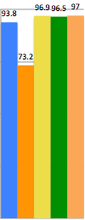


Results WikiMovie
KV-mem
Text only
KB only
Late Fusion
Early Fusion
100
75
Hits@1
50
25
0
10%
50%
100%
Percentage of KB coverage
Experiment
February 20, 2019
Notes:
On the Wiki movies dataset, very similar results are observed.

Slide 24
Conclusion and Future work
Conclusion
Graft-net can effectively use KB and Text for Question Answering
Graft-net with early fusion of KB and Text works better than late fusion
Future Work
Extend Graft-net to pick spans of text as answers rather than only entities
Improving subgraph retrieval process
A Scheme For Factoid Question Answering over Knowledge Base
February 20, 2019

